Slide 1

David C Hoaglin
Professor, University of Massachusetts Medical School
Misunderstandings about Q and ‘Cochran’s Q test’ in meta-analysis

Slide 2
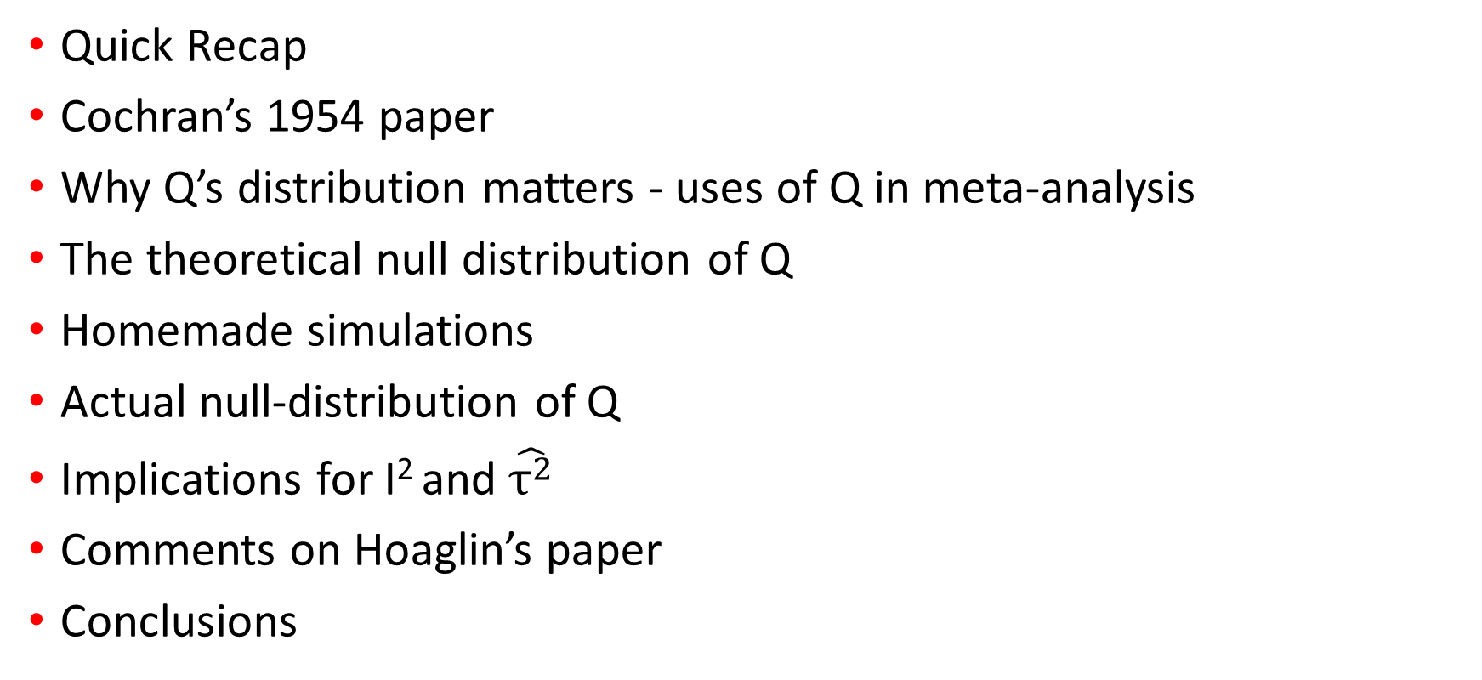
Table of contents
Quick Recap
Cochran’s 1954 paper
Why Q’s distribution matters - uses of Q in meta-analysis
The theoretical null distribution of Q
Homemade simulations
Actual null-distribution of Q
Implications for I² and $\hat{τ^{2}}$
Comments on Hoaglin’s paper
Conclusions

Slide 3
Previously on “meta-analysis”- the statistics seminar

Slide 4
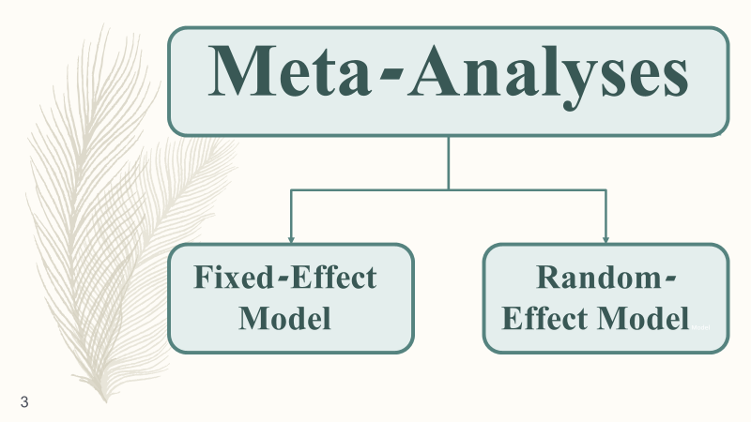
Meta-Analyses
Fixed-Effect Model
Random-Effect Model Model

Slide 5
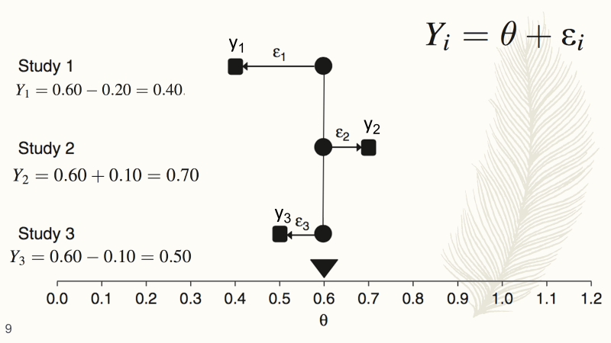
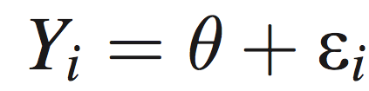
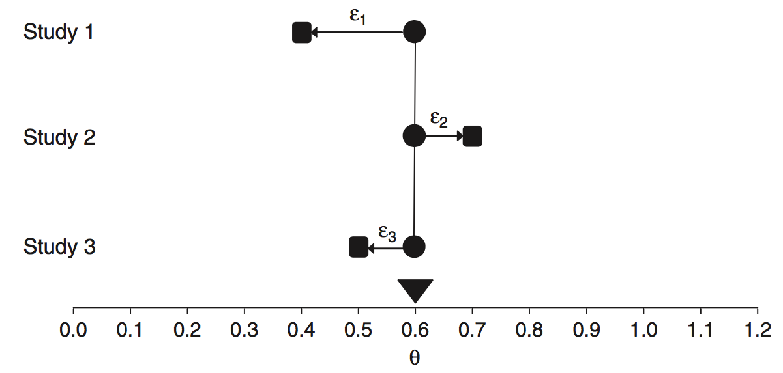
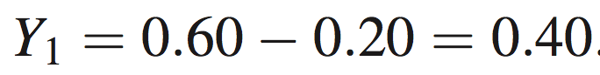
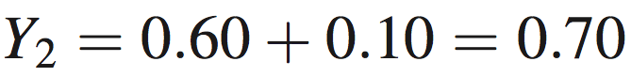
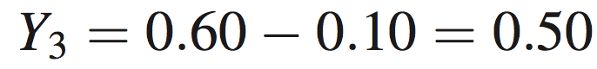
₁y
₂y
₃y

Slide 6
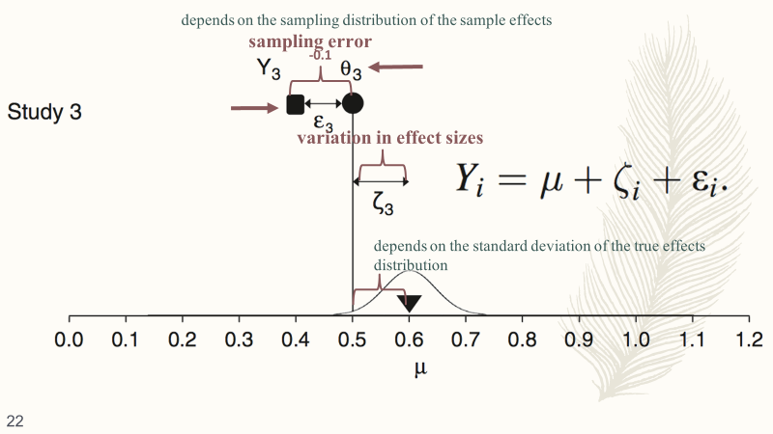

Slide 7
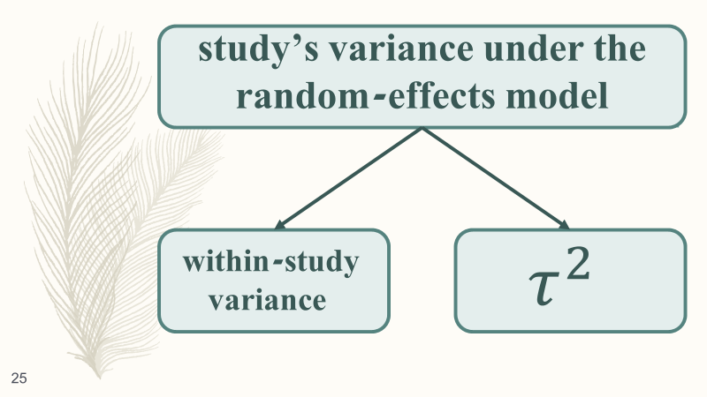

Slide 8
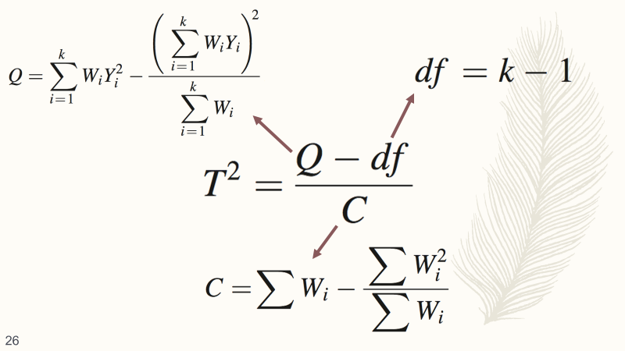

Slide 9
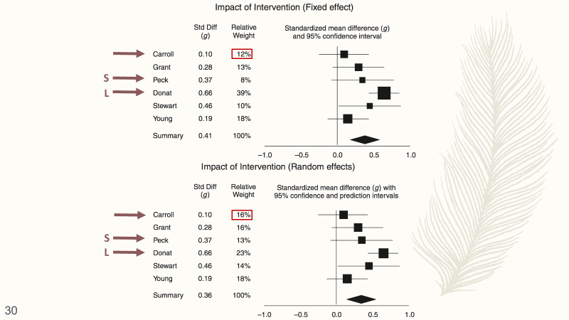

Slide 10
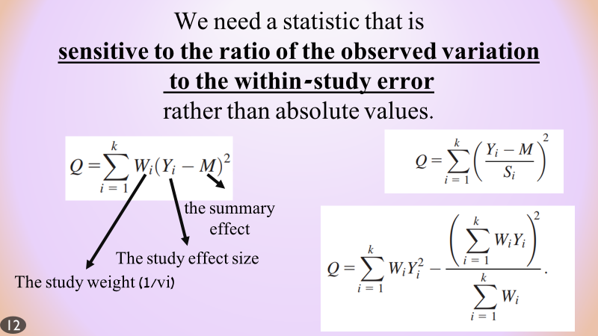
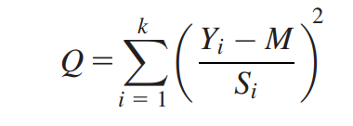
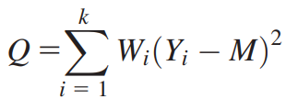
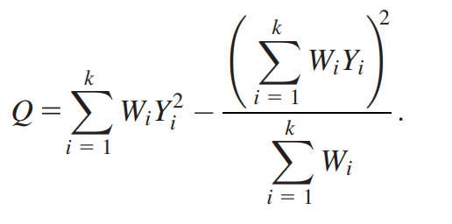
We need a statistic that is sensitive to the ratio of the observed variation to the within-study error rather than absolute values.
the summary effect
The study effect size
The study weight (1/vi)

Slide 11
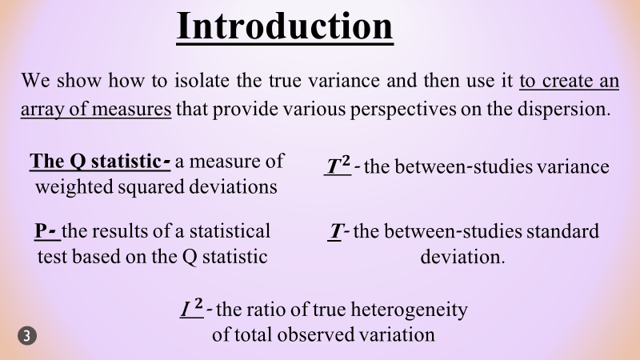
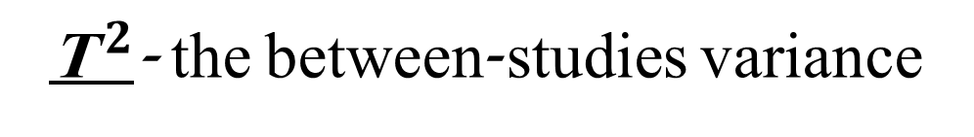
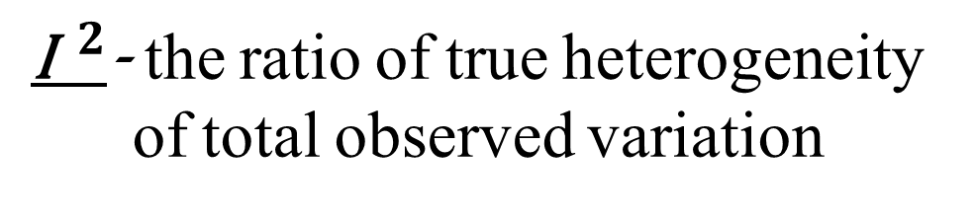
Introduction
We show how to isolate the true variance and then use it to create an array of measures that provide various perspectives on the dispersion.
The Q statistic- a measure of weighted squared deviations
${\text{T}}^{ 2}$- the between-studies variance
P- the results of a statistical test based on the Q statistic
T- the between-studies standard deviation.
${\text{I}}^{ 2}$- the ratio of true heterogeneity of total observed variation

Slide 12
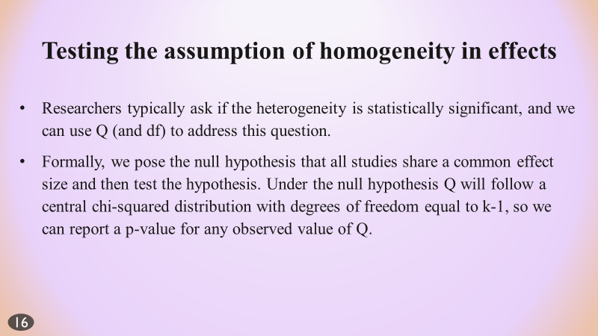
Testing the assumption of homogeneity in effects
Researchers typically ask if the heterogeneity is statistically significant, and we can use Q (and df) to address this question.
Formally, we pose the null hypothesis that all studies share a common effect size and then test the hypothesis. Under the null hypothesis Q will follow a central chi-squared distribution with degrees of freedom equal to k-1, so we can report a p-value for any observed value of Q.

Slide 13
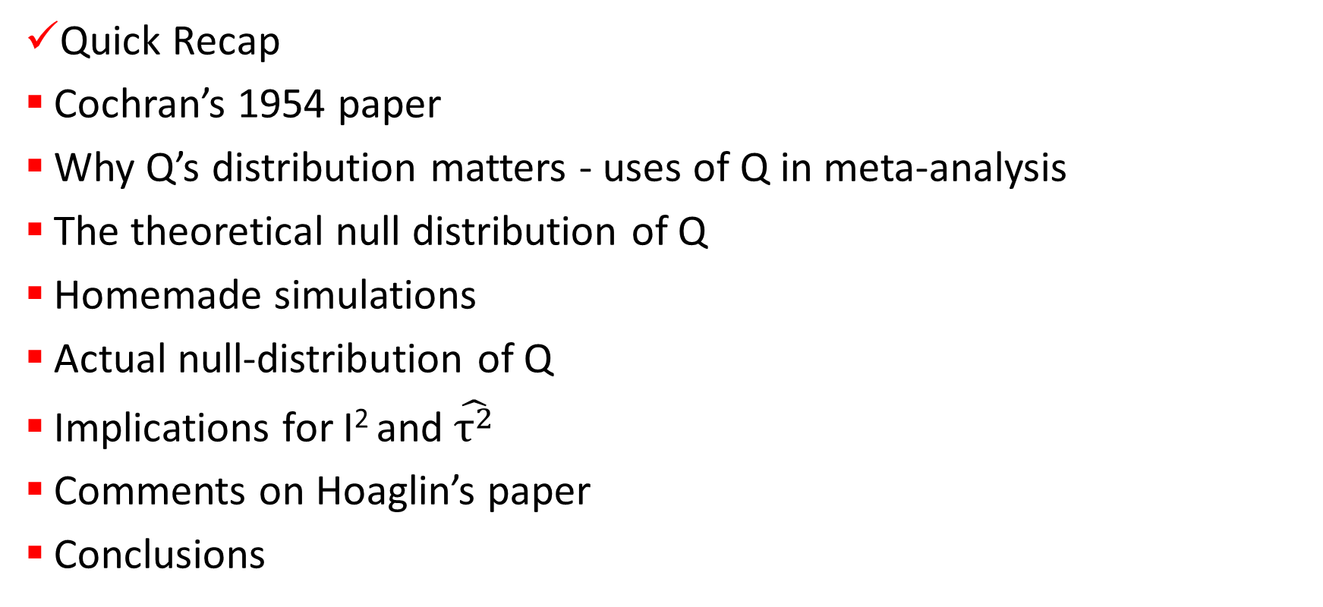
Table of contents
Quick Recap
Cochran’s 1954 paper
Why Q’s distribution matters - uses of Q in meta-analysis
The theoretical null distribution of Q
Homemade simulations
Actual null-distribution of Q
Implications for I² and $\hat{τ^{2}}$
Comments on Hoaglin’s paper
Conclusions

Slide 14

Cochran’s Q by William G. Cochran
(1909–1980)

Slide 15
Hoaglin, on the motivation for the paper
‘The impetus for this paper came from reading several articles that used ‘Cochran’s Q test’; some of them cited Cochran’s 1954 paper.’
‘Having read that paper, I was surprised. It seemed clear that those authors had not studied that paper. If they had, they would have known that Cochran deliberately did not use Q itself to test for the presence of heterogeneity.’

Slide 16
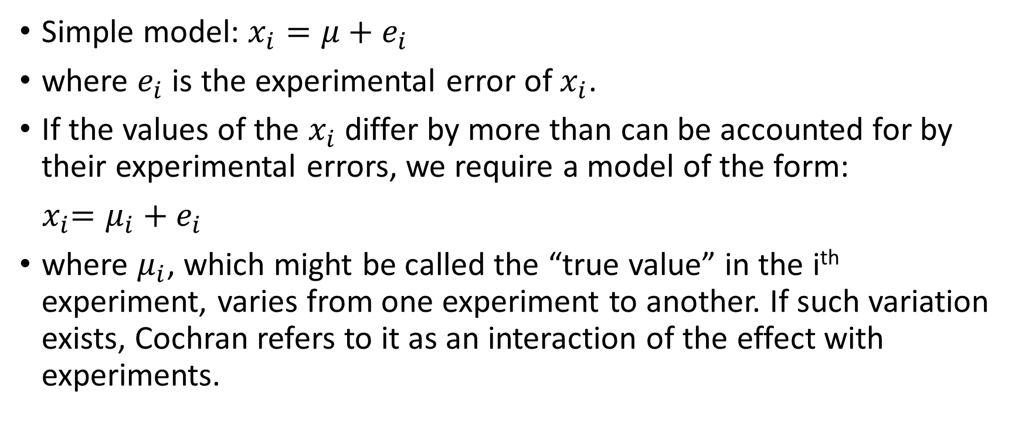
Cochran’s 1954 paper
Simple model: $x_{i}=μ+e_{i}$
where $e_{i}$ is the experimental error of $x_{i}$.
If the values of the $x_{i}$ differ by more than can be accounted for by their experimental errors, we require a model of the form:
${ x}_{i}=μ_{i}+e_{i}$
where $μ_{i}$, which might be called the “true value” in the i^{th} experiment, varies from one experiment to another. If such variation exists, Cochran refers to it as an interaction of the effect with experiments.

Slide 17
Cochran’s 1954 paper
‘The combination of the individual estimates is not a routine matter, but requires clear thinking about both the nature of the data and the function of the combined estimate.’
‘The conservative decision, when in doubt, is to assume interactions present, since the techniques for this situation remain valid even if interactions are absent.’

Slide 18
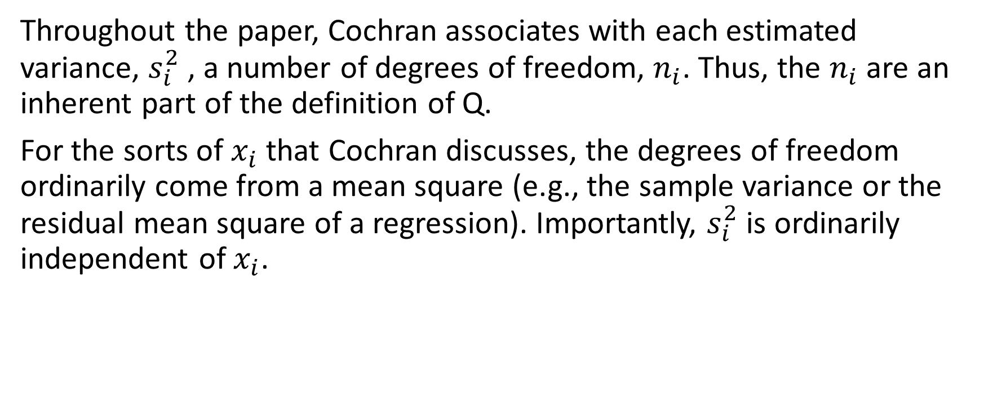
Cochran’s 1954 paper
Throughout the paper, Cochran associates with each estimated variance, $s_{i}^{2}$ , a number of degrees of freedom, $n_{i}$. Thus, the $n_{i}$ are an inherent part of the definition of Q.
For the sorts of $x_{i}$ that Cochran discusses, the degrees of freedom ordinarily come from a mean square (e.g., the sample variance or the residual mean square of a regression). Importantly, $s_{i}^{2}$ is ordinarily independent of $x_{i}$.

Slide 19
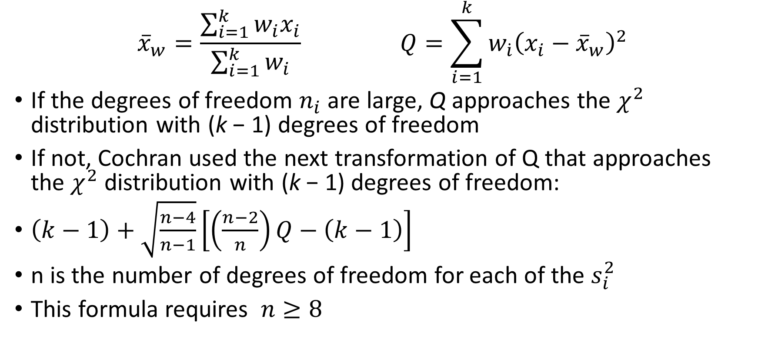
Cochran’s 1954 paper
$${\overline{x}}_{w}=\frac{\sum_{i=1}^{k}{w_{i}x_{i}}}{\sum_{i=1}^{k}{w_{i}}} Q=\sum_{i=1}^{k}{w_{\dot{i}}{\left(x_{i}−{\overline{x}}_{w}\right)}^{2}}$$
If the degrees of freedom $n_{i}$ are large, Q approaches the $χ^{2}$ distribution with (k − 1) degrees of freedom
If not, Cochran used the next transformation of Q that approaches the $χ^{2}$ distribution with (k − 1) degrees of freedom:
$\left(k−1\right)+\sqrt{\frac{n−4}{n−1}}\left[\left(\frac{n−2}{n}\right)Q−\left(k−1\right)\right]$
n is the number of degrees of freedom for each of the $s_{i}^{2}$
This formula requires $n≥8$

Slide 20
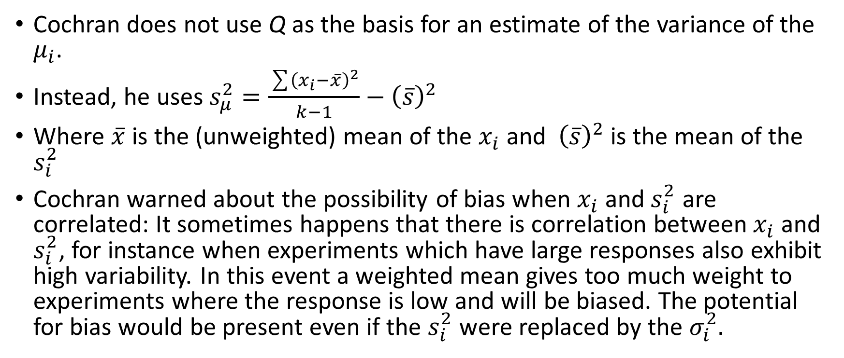
Cochran’s 1954 paper
Cochran does not use Q as the basis for an estimate of the variance of the $μ_{i}$.
Instead, he uses $s_{μ}^{2}=\frac{\sum{{\left(x_{i}−\overline{x}\right)}^{2}}}{k−1}−{\left(\overline{s}\right)}^{2}$
Where $\overline{x}$ is the (unweighted) mean of the $x_{i}$ and ${\left(\overline{s}\right)}^{2}$ is the mean of the $s_{i}^{2}$
Cochran warned about the possibility of bias when $x_{i}$ and$s_{i}^{2}$ are correlated: It sometimes happens that there is correlation between $x_{i}$ and $s_{i}^{2}$, for instance when experiments which have large responses also exhibit high variability. In this event a weighted mean gives too much weight to experiments where the response is low and will be biased. The potential for bias would be present even if the $s_{i}^{2}$ were replaced by the $σ_{i}^{2}.$

Slide 21
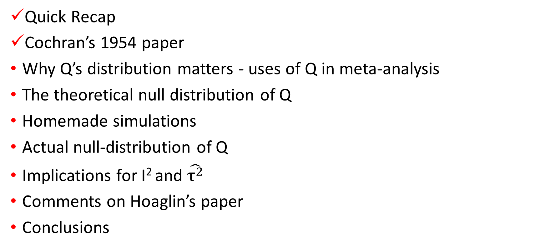
Table of contents
Quick Recap
Cochran’s 1954 paper
Why Q’s distribution matters - uses of Q in meta-analysis
The theoretical null distribution of Q
Homemade simulations
Actual null-distribution of Q
Implications for I² and $\hat{τ^{2}}$
Comments on Hoaglin’s paper
Conclusions

Slide 22
Why is Q such a big deal?

Slide 23
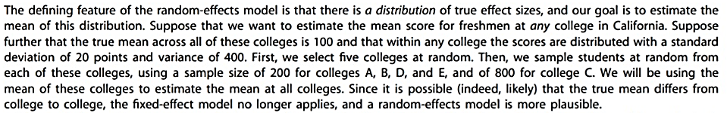
Uses of Q in Meta Analysis

Slide 24
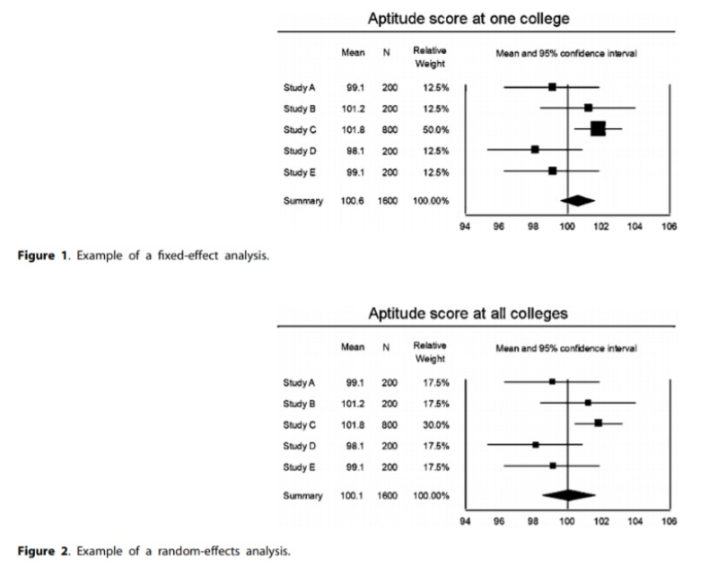
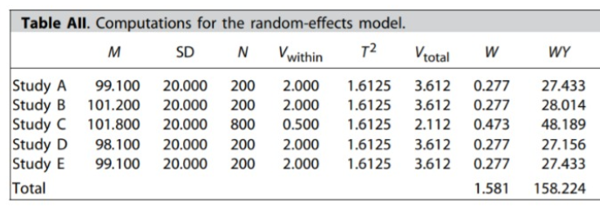

Slide 25
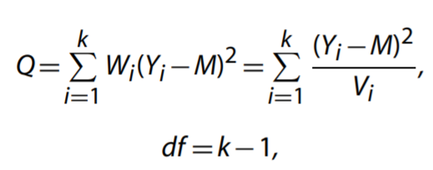
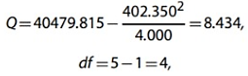
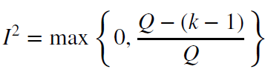
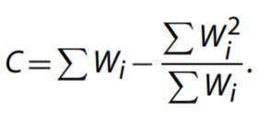

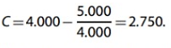
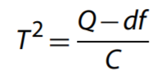
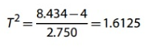
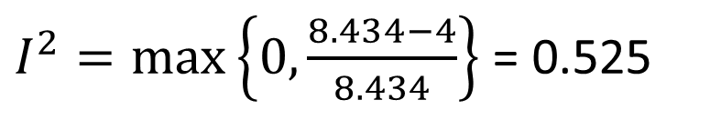
Lets trace Q’s influence on meta-analysis results
$I^{2}=\max\left\{0,\frac{8.434−4}{8.434}\right\}$ = 0.525

Slide 26
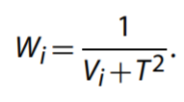
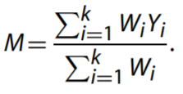
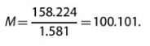
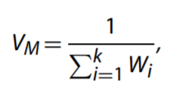
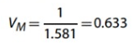
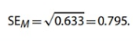
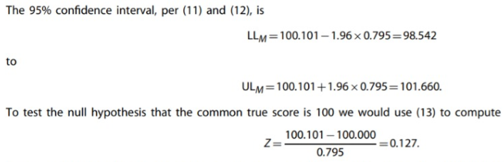
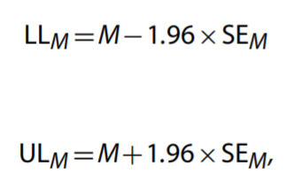

Slide 27
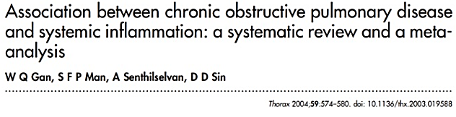
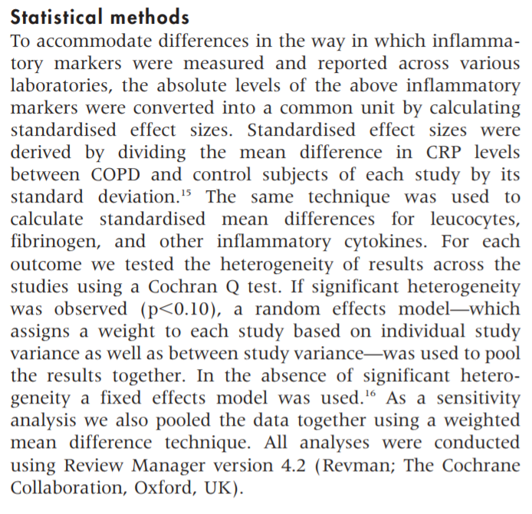

Slide 28
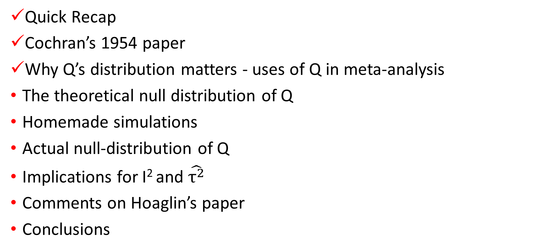
Table of contents
Quick Recap
Cochran’s 1954 paper
Why Q’s distribution matters - uses of Q in meta-analysis
The theoretical null distribution of Q
Homemade simulations
Actual null-distribution of Q
Implications for I² and $\hat{τ^{2}}$
Comments on Hoaglin’s paper
Conclusions

Slide 29
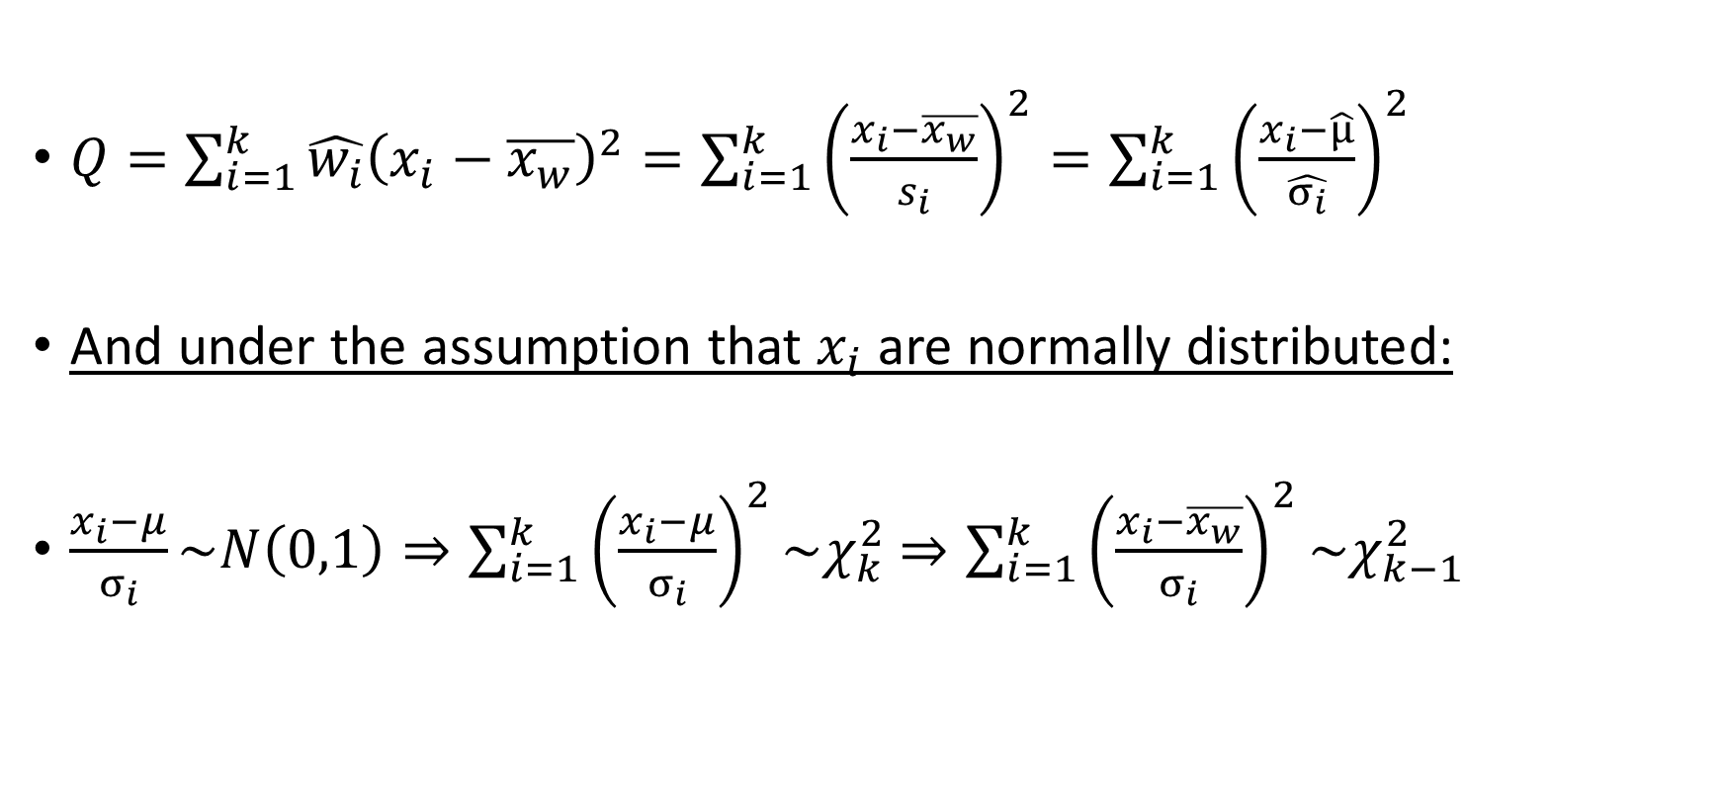
Q’s theoretical null distribution
$Q=\sum_{i=1}^{k}{\hat{w_{i}}{\left(x_{i}−\overline{x_{w}}\right)}^{2}}=\sum_{i=1}^{k}{{\left(\frac{x_{i}−\overline{x_{w}}}{s_{i}}\right)}^{2}}=\sum_{i=1}^{k}{{\left(\frac{x_{i}−\hat{μ}}{\hat{σ_{i}}}\right)}^{2}}$
And under the assumption that $x_{i}$are normally distributed:
$\frac{x_{i}−μ}{σ_{i}}\sim N\left(0,1\right)⇒\sum_{i=1}^{k}{{\left(\frac{x_{i}−μ}{σ_{i}}\right)}^{2}}\sim χ_{k}^{2}$ $⇒\sum_{i=1}^{k}{{\left(\frac{x_{i}−\overline{x_{w}}}{σ_{i}}\right)}^{2}}\sim χ_{k−1}^{2}$

Slide 30
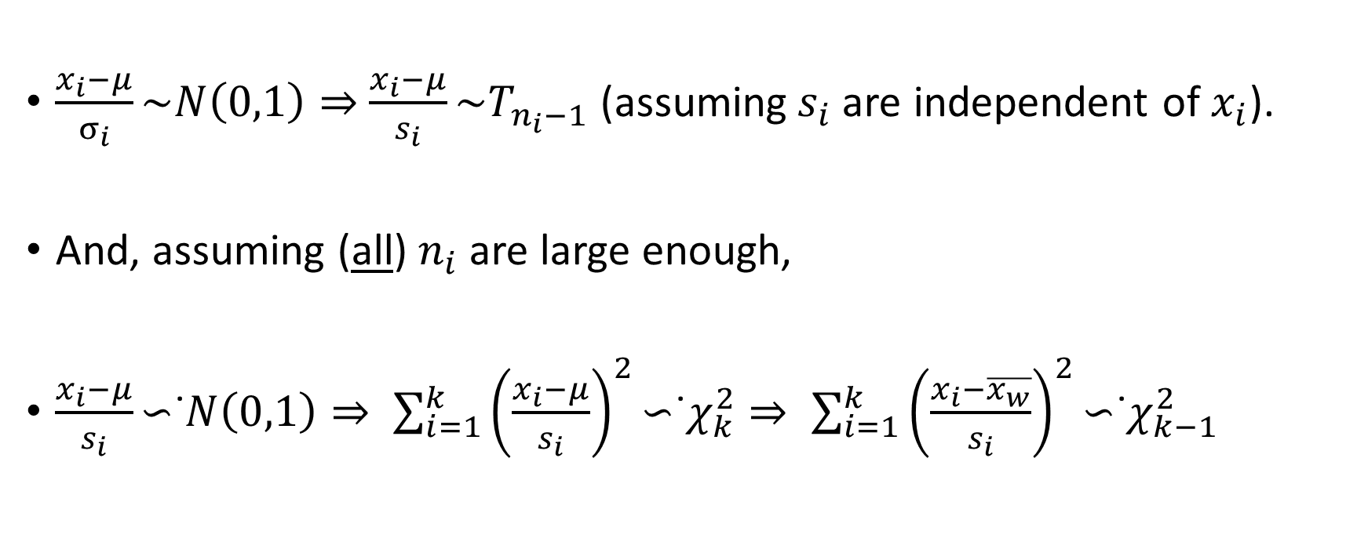
Q’s theoretical null distribution
$\frac{x_{i}−μ}{σ_{i}}\sim N\left(0,1\right)⇒$ $\frac{x_{i}−μ}{s_{i}}\text{\sim }T_{n_{i}−1}$ (assuming${ s}_{i}$are independent of $x_{i}$).
And, assuming (all) $n_{i}$ are large enough,
$\frac{x_{i}−μ}{s_{i}}\text{∼}\text{˙}N\left(0,1\right)⇒ \sum_{i=1}^{k}{{\left(\frac{x_{i}−μ}{s_{i}}\right)}^{2}}\text{∼}\text{˙}χ_{k}^{2}⇒ \sum_{i=1}^{k}{{\left(\frac{x_{i}−\overline{x_{w}}}{s_{i}}\right)}^{2}}\text{∼}\text{˙}χ_{k−1}^{2}$

Slide 31

Table of contents
Quick Recap
Cochran’s 1954 paper
Why Q’s distribution matters - uses of Q in meta-analysis
The theoretical null distribution of Q
Homemade simulations
Actual null-distribution of Q
Implications for I² and $\hat{τ^{2}}$
Comments on Hoaglin’s paper
Conclusions

Slide 32

Simulations – Mean Difference
In order to better show how the approximation of Q to the $χ_{k−1}^{2}$ distribution fares in different scenarios, we ran several simulations.
The setting for the simulations is a meta-analysis in which:
${\text{τ}}^{2}=0$, meaning there is no heterogeneity.
$x_{i}$are normally distributed (precisely, not approximately).
$x_{i}$measure raw mean differences.
$σ_{i}$ are unknown and therefore estimated by${ s}_{i}$.
$s_{i}$are independent of $x_{i}$.

Slide 33
Simulation variations:
Number of squared T variables summed (“# of studies”):
Three different variations: 3, 10 and 30 summed random variables. Marked as K from now on.
Number of observations on which T is based (“study-size”):
Three different variations: 10, 20 and 60 observations. Marked as N from now on.
Combinations of “squared-T”s with different # of observations:
Sum of K variables, all with equal study size.
Sum of K variables, half based on N observations and half with 200.
Sum of K variables, a fifth based on N observations and the rest with 200.
Each combination of simulation parameters was repeated 10,000 times.

Slide 34
Presentation of the results
We chose to present the results through the estimated PDF (probability density function), along with the corresponding chi-square PDF, which we feel best illustrates the approximations’ accuracy (or lack thereof).
For each simulation we also report the proportion of resulting values for which a “Q-test” (where α=0.05) would reject the null hypothesis of no heterogeneity being present (in other words, we present an estimation for the actual type 1 error rate).

Slide 35

Setting a baseline:
To get a better sense of what a good approximation looks like we’ll start with the distribution of the sum of squares of T-distributed random variables based on 200 observations. We’ll compare that to the sum of squares of standard normal distributed variables and the actual ${\text{χ}}_{k−1}^{2}$distribution.
$x_{i}$ - the observed effect size for the i-th study, for which N = 200.
$QGreen= \sum_{i=1}^{k}{{[(x_{i}−\overline{x})}^{2}/}s_{i}^{2}]$
$QGray=\sum_{i=1}^{k}{{[(x_{i}−\overline{x})}^{2}/}σ_{i}^{2}]$
$Black line⇒ f_{{\text{χ}}_{k−1}^{2}}$
This process was repeated 10,000 times. The lines presented next slide show the distribution of those 10,000 values.
k ∈ {3,10,30}

Slide 36

Chi-Squared (actual)
Sum of squared N(0,1)
Sum of squared T – 200 obs.
Type I Error Rate:
5.03%
5.09%

Slide 37

Chi-Squared (actual)
Sum of squared N(0,1)
Sum of squared T – 200 obs.
Type I Error Rate:
4.96%
5.18%

Slide 38

Chi-Squared (actual)
Sum of squared N(0,1)
Sum of squared T – 200 obs.
Type I Error Rate:
4.89%
5.6%

Slide 39
Equal study-size
For the first three simulations, “Q” was calculated as the sum of squares of T-distributed random variables with equal degrees of freedom.
This scenario is comparable to meta-analyses in which the samples sizes for the studies doesn’t vary too much.

Slide 40

Equal study-size
$x_{i}$: mean difference for the i-th study, for which N = 10
$y_{i}$: mean difference for the i-th study, for which N = 20
$z_{i}$: mean difference for the i-th study, for which N = 60

Slide 41

Equal study-size
$s_{x,i}^{2}$: pooled variance of $x_{i}$, having n=8 degrees of freedom.
$s_{y,i}^{2}$: pooled variance of $y_{i}$, having n=18 degrees of freedom.
$s_{z,i}^{2}$: pooled variance of $z_{i}$, having n=58 degrees of freedom.

Slide 42

Equal study-size
$QYellow= \sum_{i=1}^{k}{{[(x_{i}−\overline{x})}^{2}/}s_{x,i}^{2}]$
$QRed= \sum_{i=1}^{k}{{[(y_{i}−\overline{y})}^{2}/}s_{y,i}^{2}]$
$QBlue= \sum_{i=1}^{k}{{[(z_{i}−\overline{z})}^{2}/}s_{z,i}^{2}]$
k ∈ {3,10,30}

Slide 43

All studies – 60 obs.
All studies – 20 obs.
All studies – 10 obs.
Type I Error Rate:
5.6%
6.5%
9.3%

Slide 44

All studies – 60 obs.
All studies – 20 obs.
All studies – 10 obs.
Type I Error Rate:
6.5%
9.6%
16.6%

Slide 45

All studies – 60 obs.
All studies – 20 obs.
All studies – 10 obs.
Type I Error Rate:
7.4%
14.6%
31.2%

Slide 46
Half and half study-sizes
For the next three simulations, each “Q” was calculated as the sum of squares of T-distributed random variables, with half the variables having small sample sizes and the other half having large sample sizes.
This scenario is comparable to meta-analyses in which about half the studies have small sample sizes.

Slide 47

Half and half study-sizes
$x_{i}$: mean difference for the i-th study. Half of the studies use N=10 and the rest use N = 200.
$y_{i}$: mean difference for the i-th study. Half of the studies use N=20 and the rest use N = 200.
$z_{i}$: mean difference for the i-th study. Half of the studies use N=60 and the rest use N = 200.

Slide 48

Half and half study-sizes
$s_{x,i}^{2}$: pooled variance of $x_{i}.$Half of the sample variances have n=8 degrees of freedom and the rest have n=198 degrees of freedom .
$s_{y,i}^{2}$: pooled variance of $y_{i}$. Half of the sample variances have n=18 degrees of freedom and the rest have n=198 degrees of freedom .
$s_{z,i}^{2}$: pooled variance of $z_{i}.$ Half of the sample variances have n=58 degrees of freedom and the rest have n=198 degrees of freedom .

Slide 49
Half and half study-sizes
$QYellow= \sum_{i=1}^{k}{{[(x_{i}−\overline{x})}^{2}/}s_{x,i}^{2}]$
$QRed= \sum_{i=1}^{k}{{[(y_{i}−\overline{y})}^{2}/}s_{y,i}^{2}]$
$QBlue= \sum_{i=1}^{k}{{[(z_{i}−\overline{z})}^{2}/}s_{z,i}^{2}]$
k ∈ {3,10,30}

Slide 50

Half 60 / Half 200
Half 20 / Half 200
Half 10 / Half 200
Type I Error Rate:
5.7%
7.0%
10.1%

Slide 51

Half 60 / Half 200
Half 20 / Half 200
Half 10 / Half 200
Type I Error Rate:
6.2%
8.1%
12.9%

Slide 52

Half 60 / Half 200
Half 20 / Half 200
Half 10 / Half 200
Type I Error Rate:
6.7%
10.1%
18.9%

Slide 53
20%-80% study size split
For the next three simulations, each “Q” was calculated as the sum of squares of T-distributed random variables, with 20% of the variables having small sample sizes and 80% having large sample sizes.
This scenario is comparable to meta-analyses in which only a small portion of the studies have small sample sizes.

Slide 54

20%-80% study size split
$x_{i}$: mean difference for the i-th study. A fifth of the studies use N=10 and the rest use N=200.
$y_{i}$: mean difference for the i-th study. A fifth of the studies use N=20 and the rest use N=200.
$z_{i}$: mean difference for the i-th study. A fifth of the studies use N=60 and the rest use N=200.

Slide 55
20%-80% study size split
$s_{x,i}^{2}$: pooled variance of $x_{i}.$Half of the sample variances have n=8 degrees of freedom and the rest have n=198 degrees of freedom .
$s_{y,i}^{2}$: pooled variance of $y_{i}$. Half of the sample variances have n=18 degrees of freedom and the rest have n=198 degrees of freedom .
$s_{z,i}^{2}$: pooled variance of $z_{i}.$ Half of the sample variances have n=58 degrees of freedom and the rest have n=198 degrees of freedom .

Slide 56
20%-80% study size split
$QYellow= \sum_{i=1}^{k}{{[(x_{i}−\overline{x})}^{2}/}s_{x,i}^{2}]$
$QRed= \sum_{i=1}^{k}{{[(y_{i}−\overline{y})}^{2}/}s_{y,i}^{2}]$
$QBlue= \sum_{i=1}^{k}{{[(z_{i}−\overline{z})}^{2}/}s_{z,i}^{2}]$
k ∈ {3,10,30}

Slide 57

Fifth 60, the rest 200
Fifth 20, the rest 200
Fifth 10, the rest 200
Type I Error Rate:
5.4%
6.1%
8.1%

Slide 58

Fifth 60, the rest 200
Fifth 20, the rest 200
Fifth 10, the rest 200
Type I Error Rate:
5.8%
6.7%
8.8%

Slide 59

Fifth 60, the rest 200
Fifth 20, the rest 200
Fifth 10, the rest 200
Type I Error Rate:
5.9%
7.2%
10.1%

Slide 60
Conclusions for the mean difference simulations
It appears that for meta-analyses based on mean difference, the usage of small studies distorts the null-distribution of Q, resulting in higher Type 1 error rates than originally intended.
The distortion might still be present when the proportion of small studies is small and it worsens as K increases.

Slide 61

Table of contents
Quick Recap
Cochran’s 1954 paper
Why Q’s distribution matters - uses of Q in meta-analysis
The theoretical null distribution of Q
Homemade simulations
Actual null-distribution of Q
Implications for I² and $\hat{τ^{2}}$
Comments on Hoaglin’s paper
Conclusions
2

Slide 62
What happens when there is a dependency between the effect size and its estimated variance?

Slide 63





OR
A
B
n1
C
D
n2
$$var[\ln{\hat{(OR)}}]= \frac{1}{n_{1}∗p_{1}}+\frac{1}{n_{1}∗(1−p_{1})}+\frac{1}{n_{2}∗p_{2}}+\frac{1}{n_{2}∗\left(1−p_{2}\right)}$$
$$\hat{var[ln\left(\hat{OR)}\right]}= \frac{1}{A}+\frac{1}{B}+\frac{1}{C}+\frac{1}{D}$$

Slide 64




${ s}_{i}$are dependent of $x_{i}$.

Slide 65


Reminder:
When${ s}_{i}$ are independent of $x_{i}$:
$Z\sim N\left({0 ,5}^{2}\right)$
$X=\overline{Z}$
$X\sim N\left({0 , (5}^{2}/n)\right)$

Slide 66

Simulations- log OR
The purpose of the simulations is to show how the dependency between the effect size and its estimated variance alters the distribution of Q so that it’s no longer $χ_{k−1}^{2}$.
In this simulation we will use $LOG ODDS RATIO$as our effect size.
The setting for the simulations is a meta-analysis in which:
${\text{τ}}^{2}=0$, meaning there is no heterogeneity.
$x_{i}$are log OR –normally distributed (approximately, when $\min\left\{n_{i}∗p_{i}, n_{i}∗\left(1−p_{i}\right)\right\},iϵ\{1,2\}$is big enough).
$σ_{i}$ are unknown and therefore estimated by ${ s}_{i}$.
${ s}_{i}$are dependent of $x_{i}$.

Slide 67

Simulation variations:
“study-size”:
Three different variations: 14, 24 and 40. Marked as N from now on $\left(N=n_{1}+n_{2}, n_{1}=n_{2}\right).$These 3 parameters will stay with us for the whole simulation.
“# of studies”
P_{a},P_{c} :the “event” probability in the treated group and the controlled group.
“Combinations of studies”: small studies / large studies.
Each combination of simulation parameters was repeated 10,000 times.

Slide 68


Simulations- log OR Definition
$A_{ij}={\left(\frac{{\log\left(OR\right)}_{i}−\overline{{\log\left(OR\right)}_{w}}}{\sqrt{\hat{var({\log\left(OR\right)}_{i}}}}\right)}^{2}$
$\sum_{i}{A_{ij}}$ : analogous to Q
$jϵ \left\{N=14, N=24, N=40\right\}$

Slide 69

Simulation variations:
“study-size”:
Three different variations: 14, 24 and 40. Marked as N from now on $\left(N=n_{1}+n_{2}, n_{1}=n_{2}\right).$This 3 parameters will stay with us for the whole simulation
“# of studies”: Three different variations: 5, 10 and 30 summed random variables. Marked as K from now on.
P_{a},P_{c} :the “event” probability in the treated group and the controlled group
Combinations of studies: small studies / large studies.

Slide 70

All studies – 14 obs.
All studies – 24 obs.
All studies – 40 obs.
Type I Error Rate:
2.24%
3.77%
4.77%

Slide 71

All studies – 14 obs.
All studies – 24 obs.
All studies – 40 obs.
Type I Error Rate:
1.48%
3.49%
4.44%

Slide 72

All studies – 14 obs.
All studies – 24 obs.
All studies – 40 obs.
Type I Error Rate:
1.12%
2.76%
3.95%

Slide 73

Simulation variations:
“study-size”:
Three different variations: 14, 24 and 40. Marked as N from now on $\left(N=n_{1}+n_{2}, n_{1}=n_{2}\right).$This 3 parameters will stay with us for the whole simulation
“# of studies”: Three different variations: 5, 10 and 30 summed random variables. Marked as K from now on.
P_{a},P_{c} :the “event” probability in the treated group and the controlled group: 0.5-0.5, 0.1-0.2, 0.7-0.3, 0.5-0.9.
Combinations of studies: small studies / large studies.

Slide 74

All studies – 14 obs.
All studies – 24 obs.
All studies – 40 obs.
Type I Error Rate:
1.33%
2.91%
4.13%

Slide 75

All studies – 14 obs.
All studies – 24 obs.
All studies – 40 obs.
Type I Error Rate:
0%
0%
0%

Slide 76

All studies – 14 obs.
All studies – 24 obs.
All studies – 40 obs.
Type I Error Rate:
0.25%
1.89%
3.55%

Slide 77

All studies – 14 obs.
All studies – 24 obs.
All studies – 40 obs.
Type I Error Rate:
0%
0.04%
0.33%

Slide 78

Simulation variations:
“study-size”:
Three different variations: 14, 24 and 40. Marked as N from now on $\left(N=n_{1}+n_{2}, n_{1}=n_{2}\right).$This 3 parameters will stay with us for the whole simulation
“# of studies”: Three different variations: 5, 10 and 30 summed random variables. Marked as K from now on.
P_{a},P_{c} :the “event” probability in the treated group and the controlled group
Combinations of studies: small studies / large studies.
Large studies – N=200 ($n_{1} = n_{2} = 100$)
Small studies- N=14, N=24, N=40

Slide 79

All studies – 200 obs.
Actually we took only large samples in all the studies and not the small ones
All studies – 200 obs.
All studies – 200 obs.
Type I Error Rate:
5.37%
4.78%
5.03%

Slide 80

25% 14 obs, the rest 200.
25% 24 obs, the rest 200.
25% of the studies are small studies and the rest are large studies
25% 40 obs, the rest 200.
Type I Error Rate:
3.72%
4.49%
4.91%

Slide 81

50% 14 obs, the rest 200.
50% 24 obs, the rest 200.
50% of the studies are small studies and the rest are large studies
50% 40 obs, the rest 200.
Type I Error Rate:
2.61%
4.04%
4.13%

Slide 82

75% 14 obs, the rest 200.
75% 24 obs, the rest 200.
75% of the studies are small studies and the rest are large studies
75% 40 obs, the rest 200.
Type I Error Rate:
1.74%
3.37%
4.37%

Slide 83

All studies – 14 obs.
100% of the studies are small studies and none are large studies
All studies – 24 obs.
All studies – 40 obs.
Type I Error Rate:
1.18%
2.91%
4.19%

Slide 84

Conclusions for log OR simulations
When the estimated variance of the effect size depends on the effect, it causes a distortion of the null-distribution of Q. In our example, resulting in lower Type 1 error rates than originally intended. This lowers the power of the test.
The distortion occurs only when a major part of our data is based on small studies, and worsens when:
Increasing # of studies
P_{a},P_{c} are getting further from 0.5*, doesn’t matter if for the same direction.
* when $n_{1}, n_{2}$constants

Slide 85

Table of contents
Quick Recap
Cochran’s 1954 paper
Why Q’s distribution matters - uses of Q in meta-analysis
The theoretical null distribution of Q
Homemade simulations
Actual null-distributions of Q
Implications for I² and $\hat{τ^{2}}$
Comments on Hoaglin’s paper
Conclusions

Slide 86

But what if$x_{i}$ are not normally distributed?

Slide 87

Elena Kulinskaya
Professor of Statistics, School of Computing Sciences, University of East Anglia

Slide 88
Elena Kulinskaya
On the moments of Cochran’s Q statistic under the null hypothesis, with
application to the meta-analysis of risk difference
‘There is no exact analytic expression for the distribution of Q when the weights are treated as unknown, so an approximation must be used. Further, the distribution of Q depends on the effect measure. For example, for sample means, Q will have a different distribution than for risk differences’

Slide 89

Reminder- Risk Difference
A
B
n1
C
D
n2

Slide 90
Risk Difference
Effect size- Risk Difference
We will try to see how Cochran’s Q is distributed based on expansions for the first two moments of Q, without making any assumptions about:
The normality of the effect size- RD
The estimators of the effect and nuisance parameters of each individual study are independent.

Slide 91

Reminder- Gamma distribution
If X ~ Gamma(ν/2, 2)(shape –scale parametrization), then X is identical to χ2(ν), the chi-squared distribution with ν degrees of freedom.
Conversely, if A ~ χ2(ν) and c is a positive constant, then cA ~ Gamma(ν/2, 2c).

Slide 92


Risk difference
The approach suggested is to use the more accurate moments of Q and to refer Q to a Gamma distribution with shape parameter α and scale parameter β; in terms of the mean 𝝁 and variance $s^{2}$ of the gamma distribution, the parameters are β = $σ^{2}$/ 𝝁 and α = 𝝁 / β. Thus, estimates of these parameters are calculated from the estimated moments of Q by the relations

Slide 93




Lets calculate $E(Q)$ and $E(Q^{2})$

Slide 94
Risk difference
The gamma distribution was selected after extensive simulations and the determination that it provides an excellent fit for the distribution for Q
The gamma family includes the chi-square distributions as special cases

Slide 95

Simulations for Risk Difference
C – control
T – treatment
Δ = $p_{T} − p_{C}$= RD
$q= n_{C} / N$
I = number of studies
Balanced arms- $n_{C}$= $n_{T}$
$ζ = \left(1−q\right)∗p_{T} + q∗p_{C}$ = overall risk
Test level – false positive rate
* In this simulation Δ= 0.1

Slide 96


How $ζ$looks?
$ζ = \left(1−q\right)∗p_{T} + q∗p_{C}$ = overall risk

Slide 97

gamma, balanced arms
chi-square, balanced arms
gamma, unbalanced arms
chi-square, unbalanced arms
*
Notes:
Figure 4 displays the level of the homogeneity test on the basis of a gamma distribution whose parameters are
estimated via the moment expansions. The values of the achieved levels give the proportion of the simulations for
which the null hypothesis was rejected. We see that the levels for the gamma approximation are always superior
to the levels by using the chi-square approximation, which are always too high—meaning that the chi-square test
is always too liberal.

Slide 98

gamma, balanced arms
chi-square, balanced arms
gamma, unbalanced arms
chi-square, unbalanced arms
*

Slide 99

gamma, balanced arms
chi-square, balanced arms
gamma, unbalanced arms
chi-square, unbalanced arms
*

Slide 100

gamma, balanced arms
chi-square, balanced arms
gamma, unbalanced arms
chi-square, unbalanced arms
*

Slide 101
Conclusion of the simulation
The simulation displays the level of the homogeneity test on the basis of a gamma distribution whose parameters are estimated via the moment expansions. The values of the achieved levels give the proportion of the simulations for which the null hypothesis was rejected. We see that the levels for the gamma approximation are always superior to the levels by using the chi-square approximation, which are always too high—meaning that the chi-square test is always too liberal.

Slide 102
Kulinskaya’s approximations for Q’s distribution, based on other effect-size measures
Measure of effect size: | Approximate distribution based on Moments method:
Risk Difference | Gamma distribution
Log - OR | Gamma distribution
Raw mean difference | Multiple of F-distribution
Standardized mean difference | Chi-squared with fractional degrees of freedom

Slide 103

Table of contents
Quick Recap
Cochran’s 1954 paper
Why Q’s distribution matters - uses of Q in meta-analysis
The theoretical null distribution of Q
Homemade simulations
Actual null-distributions of Q
Implications for I² and $\hat{τ^{2}}$
Comments on Hoaglin’s paper
Conclusions

Slide 104

Implications for I²
Reminder:
Higgins and Thompson introduced I² as an estimate of $\frac{τ^{2}}{τ^{2}+σ^{2}}$
The quantity $\frac{τ^{2}}{τ^{2}+σ^{2}}$has an appealing interpretation as the proportion of total variation in the estimates of treatment effect that is due to heterogeneity between studies

Slide 105
Implications for I²
The expression [Q − (k − 1)]∕Q, however, suggests a more-cautious interpretation. Even if the null distribution of Q were chi-squared on k − 1 degrees of freedom, the probability of values exceeding the mean (k − 1) would not be small.
For example, when k = 4, that probability is 0.392; and as k increases to 30, the probability increases to 0.465.
That is, values of I² that would be interpreted as evidence of heterogeneity are quite likely under the assumed chi-squared null distribution, which corresponds to absence of heterogeneity. Under the actual null distribution of Q, large values may be even more likely.

Slide 106
Implications for I²
If one desires to retain E[Q] under the null hypothesis as the threshold for positive values of I², then E[Q] will have a separate expression for each measure of effect, and, further, each meta-analysis (with the same measure of effect) will potentially yield a different estimate of E[Q] (with variability to take into account).
In order to interpret I² effectively, it is necessary to have information on how accurately it estimates the percentage of variation associated with heterogeneity in a variety of practical situations. Such information generally appears to be lacking.

Slide 107

Implications for estimators of 𝜏²
In addition to using Q to evaluate homogeneity of treatment effect, DerSimonian and Laird [20] derive a noniterative estimate of 𝜏² ‘by equating the sample statistic with the corresponding expected value’. The resulting estimator is:

Slide 108

Implications for estimators of 𝜏²
With $w_{i}$ = 1 / $σ_{i}^{2}$ , the derivation of E(Q) is straightforward. When one uses $w_{i}$ = 1 / $s_{i}^{2}$ instead of $w_{i}$ = 1 / $σ_{i}^{2}$ , as DerSimonian and Laird do, the derivation is no longer valid.
In view of the modest study-level sample sizes in many meta-analyses, one cannot take refuge in asymptotic arguments.
Unfortunately, the Hartung–Knapp–Sidik–Jonkman method uses the DerSimonian–Laird point estimate of the overall mean effect, which has potential for bias.

Slide 109

Table of contents
Quick Recap
Cochran’s 1954 paper
Why Q’s distribution matters - uses of Q in meta-analysis
The theoretical null distribution of Q
Homemade simulations
Actual null-distributions of Q
Implications for I² and $\hat{τ^{2}}$
Comments on Hoaglin’s paper
Conclusions

Slide 110
Comments on Hoaglin’s paper

Slide 111



facebook
Wall
Photos
Name
Logout
Larry V. Hedges
Wall
Info
Photos
Information
Professor of Statistics and Education and Social Policy, Institute for Policy Research, Northwestern University
Researcher in statistical methods for meta-analysis and evaluation of education policy
Wall
Info
Photos
Friends
Contact Information

Slide 112

facebook
Wall
Photos
Name
Logout
Larry V. Hedges
Wall
Info
Photos
Hedges commented on Hoaglin’s paper:
Share
Although many of us refer to the Q-statistic described in Hoaglin’s paper as Cochran’s Q, it is correct that he did not advocate using that statistic for testing agreement in his 1954 paper. However, it is also true that the use of the Q-statistic for testing heterogeneity among results of several experiments considerably predates Cochran’s paper (for example James’ estimates from 1932).
If the limiting distribution of the estimates is normal, then the limiting distribution of Q is chi-squared under an asymptotic model where all within-study sample sizes tend to infinity at the same rate. I published a proof of this, but I assumed it was already known at the time;
Wall
Info
Photos
Friends
Friends
Tukey
Bonfferroni

Slide 113
facebook
Wall
Photos
Name
Logout
Larry V. Hedges
Wall
Info
Photos
…
I have argued elsewhere that choices of analysis should generally not be informed by testing assumptions.
I would argue that a better procedure [than testing assumptions] would be to describe heterogeneity in multiple ways. It can be described in terms of a variance component estimate or its square-root (the standard deviation of the study-specific random effects), always accompanied by a standard error or some other indication of uncertainty. In most cases, the standard error alone will demonstrate the folly of sharp inferences about heterogeneity.
Wall
Info
Photos
Friends
Friends
Tukey
Bonfferroni

Slide 114

facebook
Wall
Photos
Name
Logout
Larry V. Hedges
Wall
Info
Photos
…
I think that the motivation of $I^{2}$ is quite reasonable and that it is a natural way of characterizing heterogeneity to some researchers. Thus, $I^{2}$ will be a useful estimate to include among the arsenal of tools to think about heterogeneity.
*Because I am skeptical that sharp tests of heterogeneity are useful for model selection, I am equally skeptical whether sharp tests of hypotheses about $I^{2}$ would be useful. However, because a descriptive statistic in the spirit of $I^{2}$ seems useful, some characterization of its uncertainty does seem important, and the development of such a characterization of uncertainty (for $I^{2}$ or related indices) presents a worthwhile research problem.
Wall
Info
Photos
Friends
Friends
Tukey
Bonfferroni

Slide 115
facebook
Wall
Photos
Name
Logout
Elena Kulinskaya
Wall
Info
Photos
Information
Professor of Statistics, School of Computing Sciences, University of East Anglia
Wall
Info
Photos
Friends
Contact Information

Slide 116

facebook
Wall
Photos
Name
Logout
Elena Kulinskaya
Wall
Info
Photos
Kuliniskaya commented on Hoaglin’s paper:
Share
We congratulate David Hoaglin on this important and very timely critique of the manner in which the statistic Q is currently used in meta-analysis.
The distribution of the Q statistic very much depends on the effect measure used.
*We have investigated the moments and the distribution of Q for several effect measures: difference of means, standardized mean difference ,risk difference , and log odds ratio. In all cases, the mean of Q is not $K−1$ (without the normality assumption for the effect sizes).
For each effect size, the mean [E(Q)] can be either smaller or larger, depending on the effect measure in question (larger for the difference of means and smaller for the other measures). Further, the mean of Q will depend not only on the number of studies K but also on all of the other parameters involved (e.g. study sizes and weights)
Wall
Info
Photos
Friends
Friends
Tukey
Gauss

Slide 117

facebook
Wall
Photos
Name
Logout
Elena Kulinskaya
Wall
Info
Photos
…
*Hoaglin mentions the substantial probability of obtaining a large value of I² even under homogeneity. Another, perhaps more important, drawback of $I^{2}$ is its dependence on the sizes of the individual studies
Under heterogeneity, for a fixed K, the larger the study sizes, the larger is the value of I², converging to 100% in the limit.
To our mind, this list of important problems with I² suggests that its use in the practice of meta-analysis should be discouraged.
The single reason behind these numerous faults of standard meta-analysis practice: the misguided convention of treating various effect measures as normally distributed and their estimated variances as being constant.
In our own work, we have noticed that a large number of studies K usually require larger study sizes for theoretical results to hold.
Wall
Info
Photos
Friends
Friends
Tukey
Gauss

Slide 118
facebook
Wall
Photos
Name
Logout
Elena Kulinskaya
Wall
Info
Photos
…
*Another important example of lurking danger in meta-analysis in the case of moderate study sizes and large K is the issue of small biases. For example, estimates of log odds ratios are typically biased. This bias is small when the study size is large, but it is not negligible. When combining log odds ratios from K studies, the combined log odds ratio has the same bias, but much smaller variance. Thus, a very precise but biased result is obtained.
Wall
Info
Photos
Friends
Friends
Tukey
Gauss

Slide 119

facebook
Wall
Photos
Name
Logout
Jonathan J. Shuster
Wall
Info
Photos
Information
Professor Emeritus, Health Outcomes & Biomedical Informatics, University of Florida
Wall
Info
Photos
Friends
Contact Information

Slide 120


facebook
Wall
Photos
Name
Logout
Jonathan J. Shuster
Wall
Info
Photos
Shuster commented on Hoaglin’s paper:
Share
Despite the better approximations for the distribution of Q, it might be better to look for alternatives to Q and I² to describe heterogeneity.
Note that the intended role of Q is similar to the role of the F-statistic in a repeated-measures two-way (one fixed effect and one random effect) analysis of variance. As such, it does not provide an estimate of a physical standard deviation or the precision of such an estimate.
Cochran estimated Var(μ_{i}) = Var(x_{i}) - Var(e_{i}) by:
where $\overline{x}$ and $\overline{y}$ are the sample means of the study specific x_{i} and squared standard errors y_{i}= s_{i}² , respectively. As the number of studies, k, becomes large, using the delta method, the estimated standard deviation of the μ_{i}, V_{μ} is asymptotically unbiased and asymptotically normally distributed.
Wall
Info
Photos
Friends
Friends
Tukey
Pearson

Slide 121

Table of contents
Quick Recap
Cochran’s 1954 paper
Why Q’s distribution matters - uses of Q in meta-analysis
The theoretical null distribution of Q
Homemade simulations
Actual null-distributions of Q
Implications for I² and $\hat{τ^{2}}$
Comments on Hoaglin’s paper
Conclusions

Slide 122

Conclusions
The distribution of Q is approximately (in large samples), and not exactly, chi-squared because the weights used are $1/s_{i}^{2}$and not 1/$σ_{i}^{2}$ .
In theoretical work, it is customary to assume that one can use the $s_{i}^{2}$ as if they were the $σ_{i}^{2};$ but this assumption can lead to problems, and it is supported by little, if any, empirical evidence in moderate and small samples.
Thus, results that rely on this assumption (such as those claiming to derive the exact distribution of Cochran’s Q) are mainly of theoretical interest; their relevance to actual meta-analyses remains unproven.

Slide 123
Conclusions
Information from Cochran’s paper, together with results from the work of Kulinskaya et al. provides an accurate description of the behavior of Q and should help to counteract some of the widespread misinformation.
Analysts who would like to test for heterogeneity by referring Q to the chi-squared distribution on k−1 degrees of freedom are likely to be disappointed at losing the simplicity and uniformity of that approach, but its validity was always an illusion.

Slide 124
Conclusions
Shuster recommends that books on meta-analysis take into account current knowledge about Q, and Kulinskaya and Dollinger make a similar point about software.
Those changes are essential for improving the present unsatisfactory situation. Software could readily omit P-values for Q. Output could also omit I² , in its current form.
Software documentation, and books as well, should include forthright discussions of the limitations of Q and I², as well as the shortcomings of procedures that use weights based on estimated variances.

